Slide 1
Task 1: SOLVING THE VULNERABILITIES OF XSS LABS AT P0RTSWIGGER
STEPS TO BE FOLLOWED:
STEP 1: OPEN VIRTUAL BOX AND LOGIN TO KALI LINUX
STEP 2: OPEN FIREFOX IN LINUX AND SEARCH PORTSWIGGER
STEP 3: SIGN UP TO PORT SWIGGER AFTER SIGNING UP SIGN IN TO THE WEBSITE
STEP 4: OPEN YOUR PROFILE THEN OPEN THE VULNERABILITIES LIST
STEP 5:NOW CHECK WHETHER THE XSS LAB VULNERABILITIES ARE AVAILABLE OR NOT
STEP 6: NOW START SOLVING THE VULNERABILITIES OF XSS LABS BY USING PAYLOADS
STEP 7: PAYLOADS CAN BE DOWNLOADED FROM GITHUB
STEP 8: SOLVE ANY 5 OF THE GIVEN VULNERABILITIES,THE TASK IS FINISHED

Slide 2
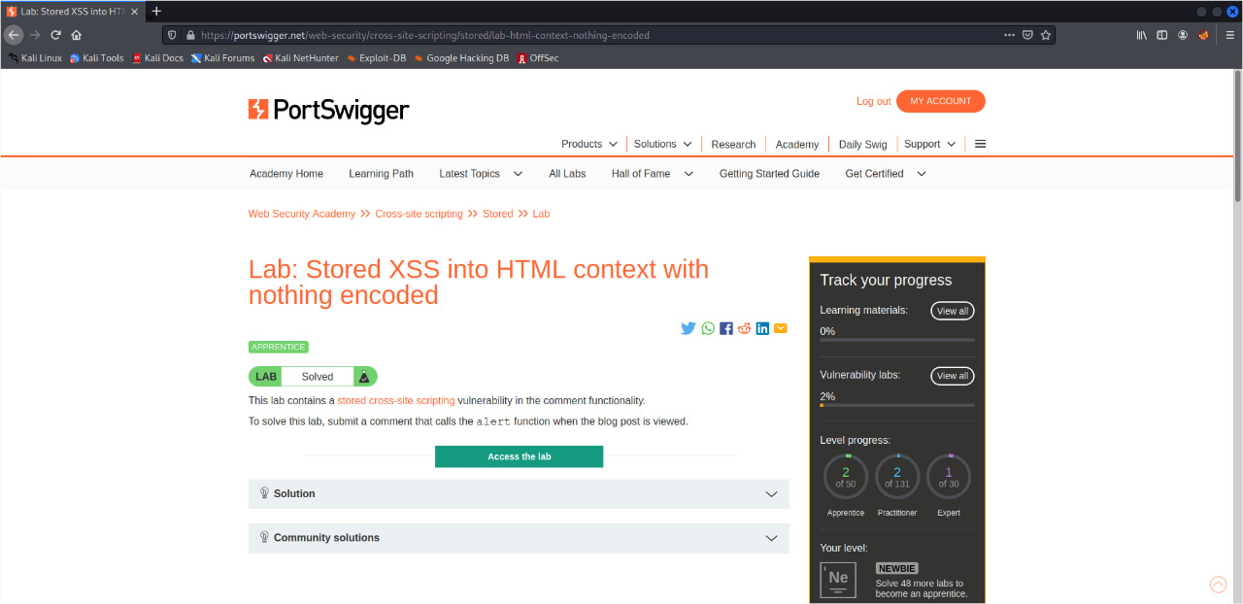

Slide 3
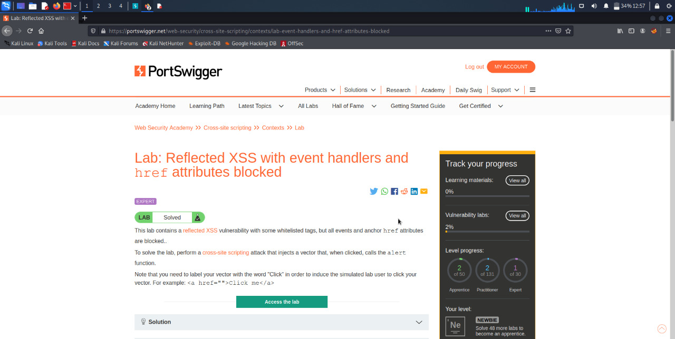

Slide 4
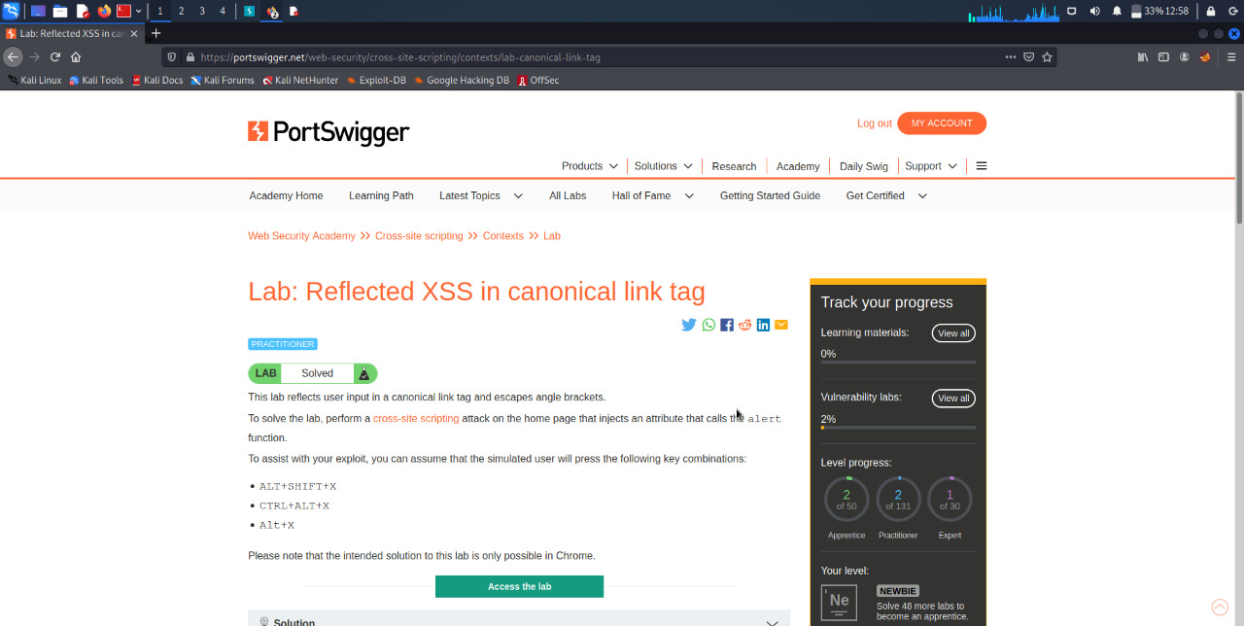

Slide 5
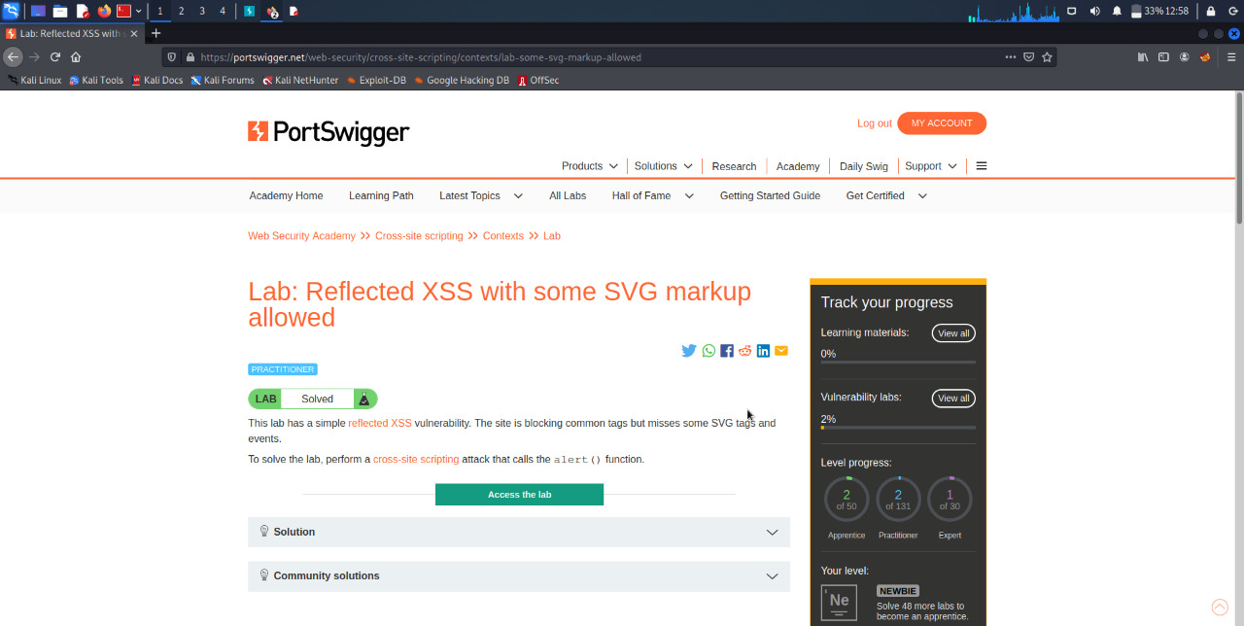

Slide 6
